Slide 1
COMP 2710 Software Construction
Review for Mid-Term Exam
Dr. Alvin Lim
Auburn University
http://www.eng.auburn.edu/~lim
limalvi@auburn.edu
Fall 2014

Slide 2
Expressions: Type Casting
Two types
  Implicit—also called "Automatic"
    Done FOR you, automatically
    17 / 5.5
    This expression causes an "implicit type cast" to
    take place, casting the 17 → 17.0
  Explicit type conversion
    Programmer specifies conversion with cast operator
    (double)17 / 5.5
    Same expression as above, using explicit cast
    (double)myInt / myDouble
    More typical use; cast operator on variable
Copyright © 2008 Pearson Addison-Wesley. All rights reserved.
1-<number>

Slide 3
Shorthand Operators
Increment & Decrement Operators
  Just short-hand notation
  Increment operator, ++
  intVar++; is equivalent to
  intVar = intVar + 1;
  Decrement operator, --
  intVar--; is equivalent to
  intVar = intVar – 1;
Copyright © 2008 Pearson Addison-Wesley. All rights reserved.
1-<number>

Slide 4
Shorthand Operators: Two Options
Post-Increment
intVar++
  Uses current value of variable, THEN increments it
Pre-Increment
++intVar
  Increments variable first, THEN uses new value
"Use" is defined as whatever "context"
variable is currently in
No difference if "alone" in statement:
intVar++; and ++intVar; → identical result
Copyright © 2008 Pearson Addison-Wesley. All rights reserved.
1-<number>

Slide 5
Flow of Control: Summary
C++ loop statements
  while
  do-while
  For
do-while loops
  Always execute their loop body at least once
for-loop
  A natural "counting" loop
Loops can be exited early
  break statement
  continue statement
  Usage restricted for style purposes
Copyright © 2008 Pearson Addison-Wesley. All rights reserved.
2-<number>

Slide 6

The break and continue Statements
Flow of Control
  Recall how loops provide "graceful" and clear flow of control in and out
  In RARE instances, can alter natural flow
break;
  Forces loop to exit immediately.
continue;
  Skips rest of loop body
These statements violate natural flow
  Only used when absolutely necessary!
Copyright © 2008 Pearson Addison-Wesley. All rights reserved.
2-<number>

Slide 7
Nested Loops
Recall: ANY valid C++ statements can be
inside body of loop
This includes additional loop statements!
  Called "nested loops"
Requires careful indenting:
for (outer=0; outer<5; outer++)
for (inner=7; inner>2; inner--)
cout << outer << inner;
  Notice no { } since each body is one statement
  Good style dictates we use { } anyway
Copyright © 2008 Pearson Addison-Wesley. All rights reserved.
2-<number>

Slide 8
Parameters
Two methods of passing arguments
as parameters
Call-by-value
  "copy" of value is passed
Call-by-reference
  "address of" actual argument is passed
Copyright © 2008 Pearson Addison-Wesley. All rights reserved.
4-<number>

Slide 9
Call-by-Value Parameters
Copy of actual argument passed
Considered "local variable" inside function
If modified, only "local copy" changes
  Function has no access to "actual argument"
  from caller
This is the default method
  Used in all examples thus far
Copyright © 2008 Pearson Addison-Wesley. All rights reserved.
4-<number>

Slide 10
Call-By-Reference Parameters
Used to provide access to caller’s
actual argument
Caller’s data can be modified by called function!
Typically used for input function
  To retrieve data for caller
  Data is then "given" to caller
Specified by ampersand, &, after type
in formal parameter list
Copyright © 2008 Pearson Addison-Wesley. All rights reserved.
4-<number>

Slide 11
Call-By-Reference Details
What’s really passed in?
A "reference" back to caller’s
actual argument!
  Refers to memory location of
  actual argument
  Called "address", which is a unique number
  referring to distinct place in memory
Copyright © 2008 Pearson Addison-Wesley. All rights reserved.
4-<number>

Slide 12
Constant Reference Parameters
Reference arguments inherently
"dangerous"
  Caller’s data can be changed
  Often this is desired, sometimes not
To "protect" data, & still pass by reference:
  Use const keyword
    void sendConstRef( const int &par1,
    const int &par2);
    Makes arguments "read-only" by function
    No changes allowed inside function body
Copyright © 2008 Pearson Addison-Wesley. All rights reserved.
4-<number>

Slide 13
Struct and Class: Summary
Structure is collection of different types
Class used to combine data and functions
into single unit -> object
Member variables and member functions
  Can be public → accessed outside class
  Can be private → accessed only in a member
  function’s definition
Class and structure types can be formal
parameters to functions
Copyright © 2008 Pearson Addison-Wesley. All rights reserved.
6-<number>

Slide 14
Summary 2
C++ class definition
  Should separate two key parts
    Interface: what user needs
    Implementation: details of how class works
6-<number>
Copyright © 2010 Pearson Addison-Wesley. All rights reserved.

Slide 15
Constructors
Initialization of objects
  Initialize some or all member variables
  Other actions possible as well
A special kind of member function
  Automatically called when object declared
Very useful tool
  Key principle of OOP
Copyright © 2008 Pearson Addison-Wesley. All rights reserved.
7-<number>

Slide 16
Constructor Definitions
Constructors defined like any
member function
  Except:
    Must have same name as class
    Cannot return a value; not even void!
Copyright © 2008 Pearson Addison-Wesley. All rights reserved.
7-<number>
Notes:
It is supposed to initialize member variables.

Slide 17
Overloaded Constructors
Can overload constructors just like
other functions
Recall: a signature consists of:
  Name of function
  Parameter list
Provide constructors for all possible
argument-lists
  Particularly "how many"
Copyright © 2008 Pearson Addison-Wesley. All rights reserved.
7-<number>

Slide 18
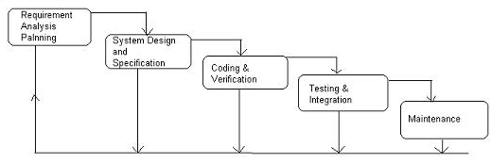
The Waterfall Lifecycle
1-<number>

Slide 19
OO Design: Class Diagram
Translate objects described in Analysis (Big Picture and Use Cases) into software classes
Not everything may translate exactly!
  You may have to fabricate new “imaginary” objects. Some real-world objects aren’t relevant to the functioning of the system or may be attributes.
Show relationships (and numbering) between classes
  Why?
Attribute data and functionality to each Object
1-<number>

Slide 20
Class Diagram: Add Associations and Numbering
MenuGUI
1
1
DL System
1
1
1
1
1
1
StudentDB
LibrarianDB
MediaItemDB
1
1
1
*
*
*
Student
Librarian
MediaItem
1-<number>
1
*

Slide 21
Relationships: Association
Models a semantic connection among classes
Association Name
Professor
Works for
University
Association
Role Names
Class
Professor
University
Employee
Employer
Notes:
Associations connect instances of two or more classes together for some duration (as opposed to a dependency relationship, which represents a temporary association between two instances).
Dependency relationships will be discussed in the Class Design module.
Do not use relationship/role names if they add no value/information to the model. Remember, readability and understandability of the model are key -- only add information that adds value, not clutter to the diagrams.

Slide 22
Relationships: Aggregation
A special form of association that models a whole-part relationship between an aggregate (the whole) and its parts
Whole
Part
Student
Schedule
Aggregation
Notes:
There are many examples of whole-part relationships: a Library contains Books, within a company Departments are made-up of Employees, a Computer is composed of a number of Devices. However, whether you model a relationship as an association or aggregation is really dependent on the domain being modeled. This is discussed in more detail on a later slide.

Slide 23
Relationships: Composition
A form of aggregation with strong ownership and coincident lifetimes
  The parts cannot survive the whole/aggregate
Whole
Part
Student
Schedule
Aggregation
Notes:
Explain to the students that the diamond on this slide must be filled in with black so that the books would print right. If it was filled in with white, it would not be filled in in the books.
Note: Compositional aggregation can be shown in by nesting one class within another; however, Rose does not directly support the drawing of a class within a class.
Composition is not equivalent to containment by value, as some languages do not support containment by value (e.g., Java). By-value vs. by-reference is an implementation “thing”, whereas composition is a conceptual “thing” that can realized in the implementation using by-value, or by-reference (if the distinction is supported).
Note: In Rose, composition is modeled by specifying “by-value” for the containment property of a role of a relationship.

Slide 24
Association: Multiplicity
Unspecified
Exactly one
Zero or more (many, unlimited)
One or more
Zero or one
Specified range
Multiple, disjoint ranges
1
0..*
*
1..*
0..1
2..4
2, 4..6
Notes:
Specification of multiplicity flushes out business rules and assumptions. The lower bound is critical, as the lower bound is what determines whether or not the relationship is optional (e.g., a lower bound of 0 indicates that the relationship is optional).
Multiplicity is needed on both ends of a relationship, even if you can only navigate in one direction. Even though there is no need to navigate in that direction, the multiplicity still provides valuable business information. Sometimes navigation decisions are made for performance reasons, which may change over time. The multiplicity should reflect the requirements.
Navigation is discussed on later slides.
The use of ‘N’ instead of ‘*’ is Booch, not UML (e.g., the use of “0..N” and ‘N’ is not UML).

Slide 25
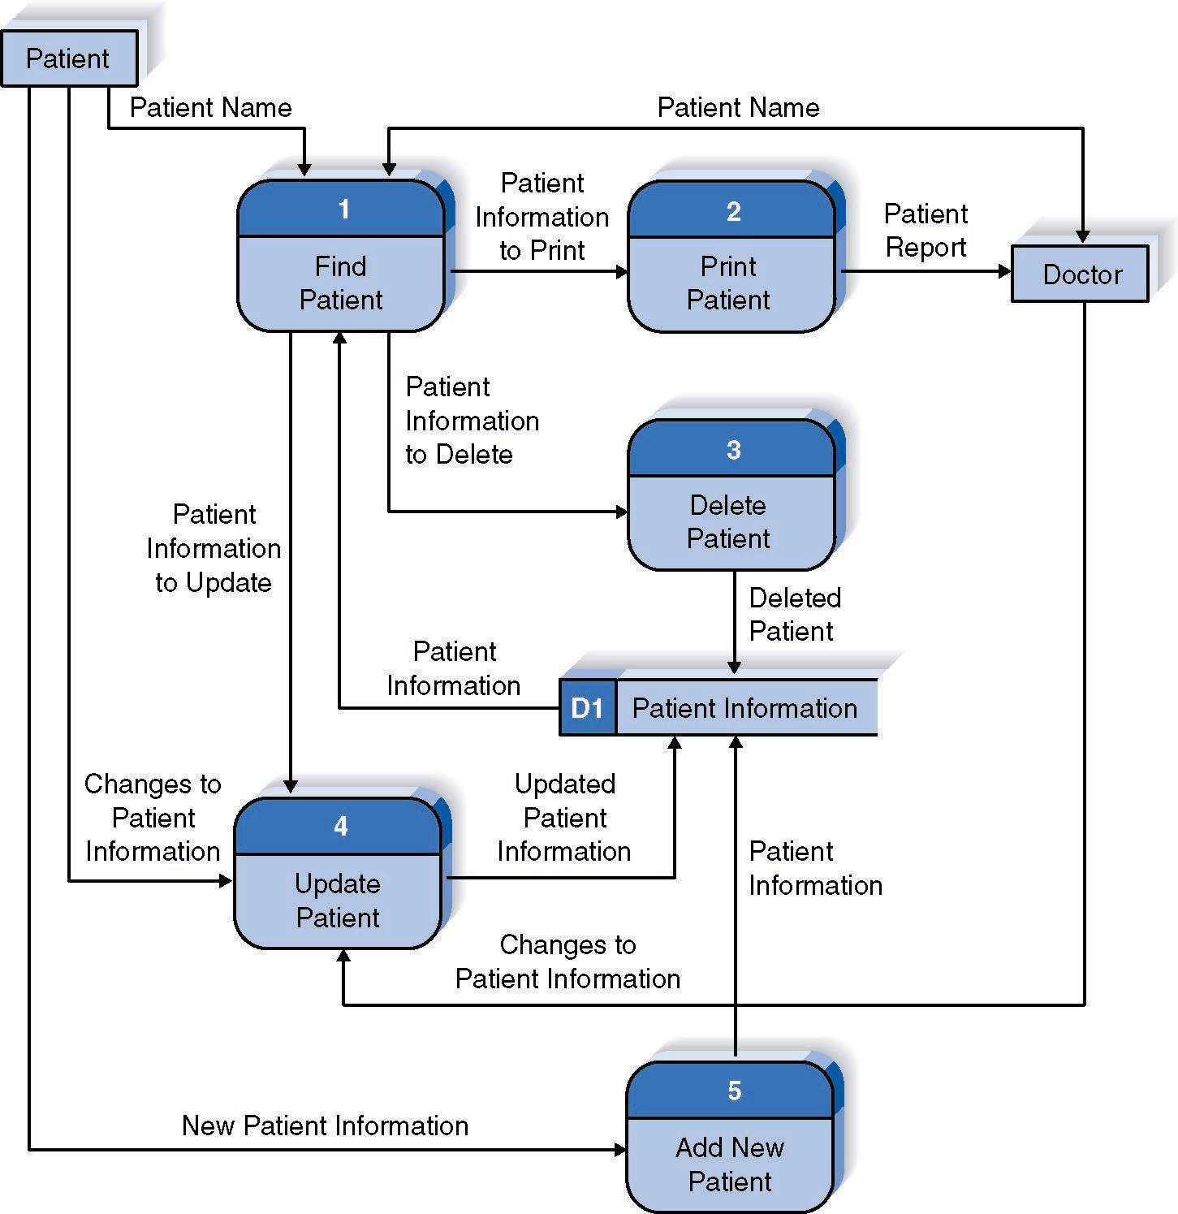
Reading a DFD
1-<number>

Slide 26
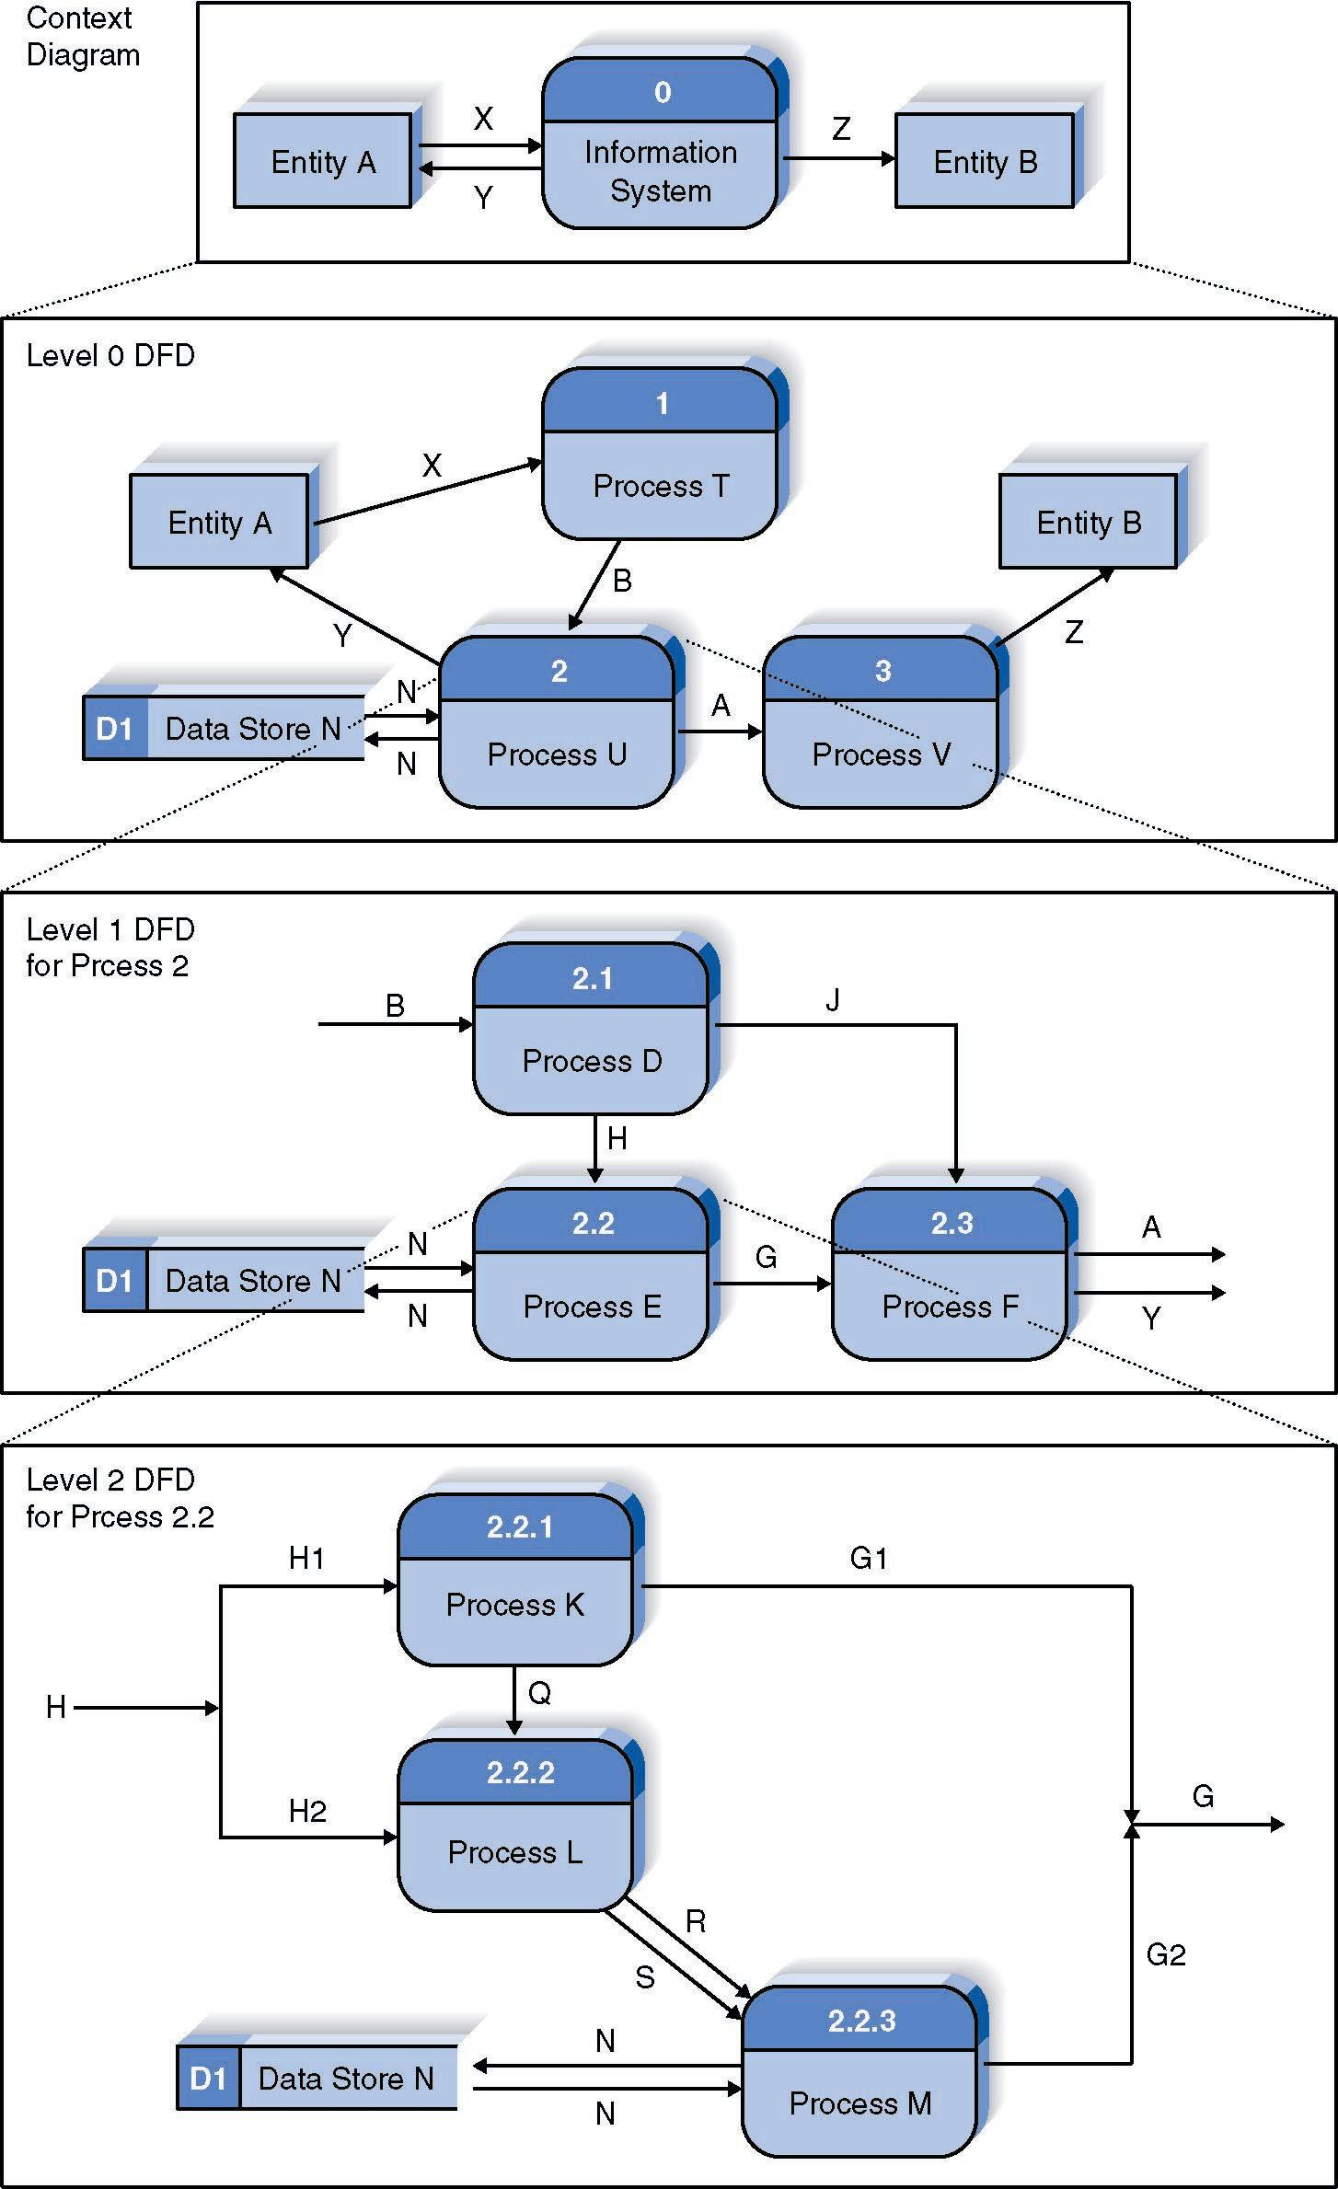
Relationship Among DFD levels
1-<number>

Slide 27
DFD Common Errors
A processing step may have input flows but no output flows. This situation is sometimes called a black hole.
A processing step may have output flows but no input flows. This situation is sometimes called a miracle.
A processing step may have outputs that are greater than the sum of its inputs - e.g., its inputs could not produce the output shown. This situation is sometimes referred to as a grey hole.
1-<number>

Slide 28
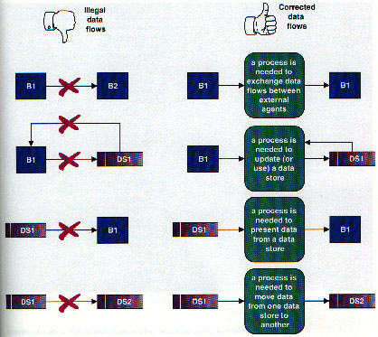
Illegal Data Flows
1-<number>

Slide 29
Types of Testing
Unit Testing
  Isolate a single function or class and test only that. This generally requires holding other functions constant or at least making them predictable (remember drivers and stubs?)
System Wide/Integration Testing
  Does the whole system meet its goals?
  Does the whole system work correctly?
  System Test Cases should map back to Use Cases!

Slide 30
The assert Macro
Assertion: a true or false statement
Used to document and check correctness
  Preconditions & Postconditions
    Typical assert use: confirm their validity
  Syntax:
  assert(<assert_condition>);
    No return value
    Evaluates assert_condition
    Terminates if false, continues if true
Predefined in library <cassert>
  Macros used similarly as functions
Copyright © 2008 Pearson Addison-Wesley. All rights reserved.
4-<number>

Slide 31
An assert Macro Example
Given Function Declaration:
void computeCoin( int coinValue,
int& number,
int& amountLeft);
//Precondition: 0 < coinValue < 100
0 <= amountLeft <100
//Postcondition: number set to max. number
of coins
Check precondition:
  assert ((0 < currentCoin) && (currentCoin < 100)
  && (0 <= currentAmountLeft) && (currentAmountLeft < 100));
  If precondition not satisfied → condition is false → program execution terminates!
Copyright © 2008 Pearson Addison-Wesley. All rights reserved.
4-<number>

Slide 32
Stubs and Drivers
Separate compilation units
  Each function designed, coded, tested
  separately
  Ensures validity of each unit
  Divide & Conquer
    Transforms one big task → smaller,
    manageable tasks
But how to test independently?
  Driver programs
Copyright © 2008 Pearson Addison-Wesley. All rights reserved.
4-<number>

Slide 33
Test Driver
A class or utility program that applies test cases to a component being tested.
How to write a test driver?
Test cases

Slide 34
Stubs
Develop incrementally
Write "big-picture" functions first
  Low-level functions last
  "Stub-out" functions until implementation
  Example:
  double unitPrice(int diameter, double price)
  {
  return (9.99); // not valid, but noticeably
  // a "temporary" value
  }
  Calls to function will still "work"
Copyright © 2008 Pearson Addison-Wesley. All rights reserved.
4-<number>

